Slide 1
CHAPTER 7: The CPU and Memory
The Architecture of Computer Hardware, Systems Software & Networking: An Information Technology Approach
4th Edition, Irv Englander
John Wiley and Sons ©2010

Slide 2
CPU: Major Components
ALU (arithmetic logic unit)
Performs calculations and comparisons
CU (control unit)
Performs fetch/execute cycle
Accesses program instructions and issues commands to the ALU
Moves data to and from CPU registers and other hardware components
Subcomponents:
Memory management unit: supervises fetching instructions and data from memory
I/O Interface: sometimes combined with memory management unit as Bus Interface Unit

Slide 3
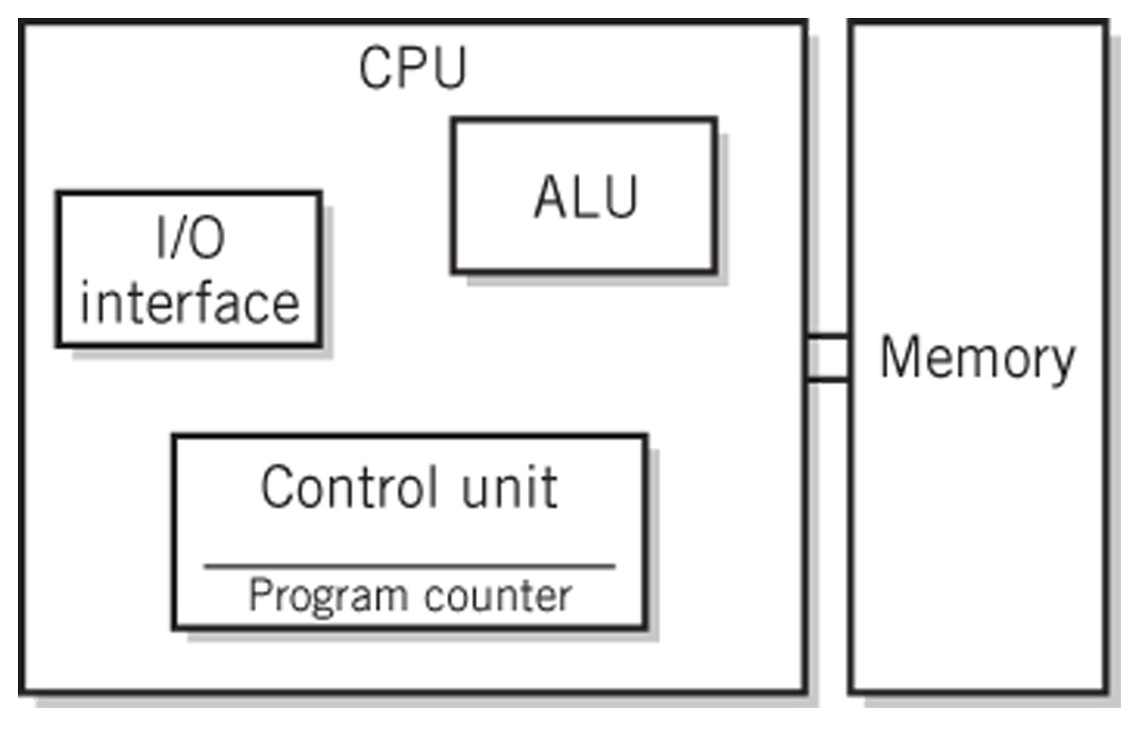
System Block Diagram

Slide 4
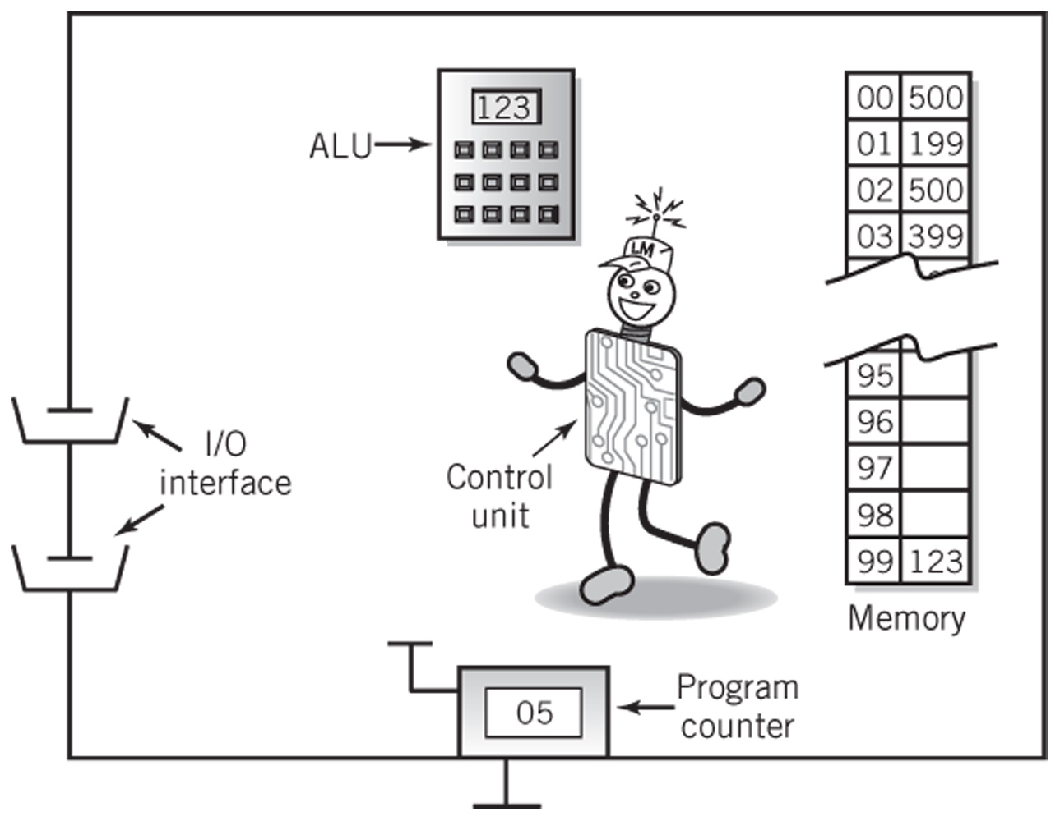
The Little Man Computer

Slide 5
Concept of Registers
Small, permanent storage locations within the CPU used for a particular purpose
Manipulated directly by the Control Unit
Wired for specific function
Size in bits or bytes (not in MB like memory)
Can hold data, an address or an instruction
How many registers does the LMC have?
What are the registers in the LMC?

Slide 6
Registers
Use of Registers
Scratchpad for currently executing program
Holds data needed quickly or frequently
Stores information about status of CPU and currently executing program
Address of next program instruction
Signals from external devices
General Purpose Registers
User-visible registers
Hold intermediate results or data values, e.g., loop counters
Equivalent to LMC’s calculator
Typically several dozen in current CPUs

Slide 7
Special-Purpose Registers
Program Count Register (PC)
Also called instruction pointer
Instruction Register (IR)
Stores instruction fetched from memory
Memory Address Register (MAR)
Memory Data Register (MDR)
Status Registers
Status of CPU and currently executing program
Flags (one bit Boolean variable) to track condition like arithmetic carry and overflow, power failure, internal computer error

Slide 8
Register Operations
Stores values from other locations (registers and memory)
Addition and subtraction
Shift or rotate data
Test contents for conditions such as zero or positive

Slide 9
Operation of Memory
Each memory location has a unique address
Address from an instruction is copied to the MAR which finds the location in memory
CPU determines if it is a store or retrieval
Transfer takes place between the MDR and memory
MDR is a two way register

Slide 10
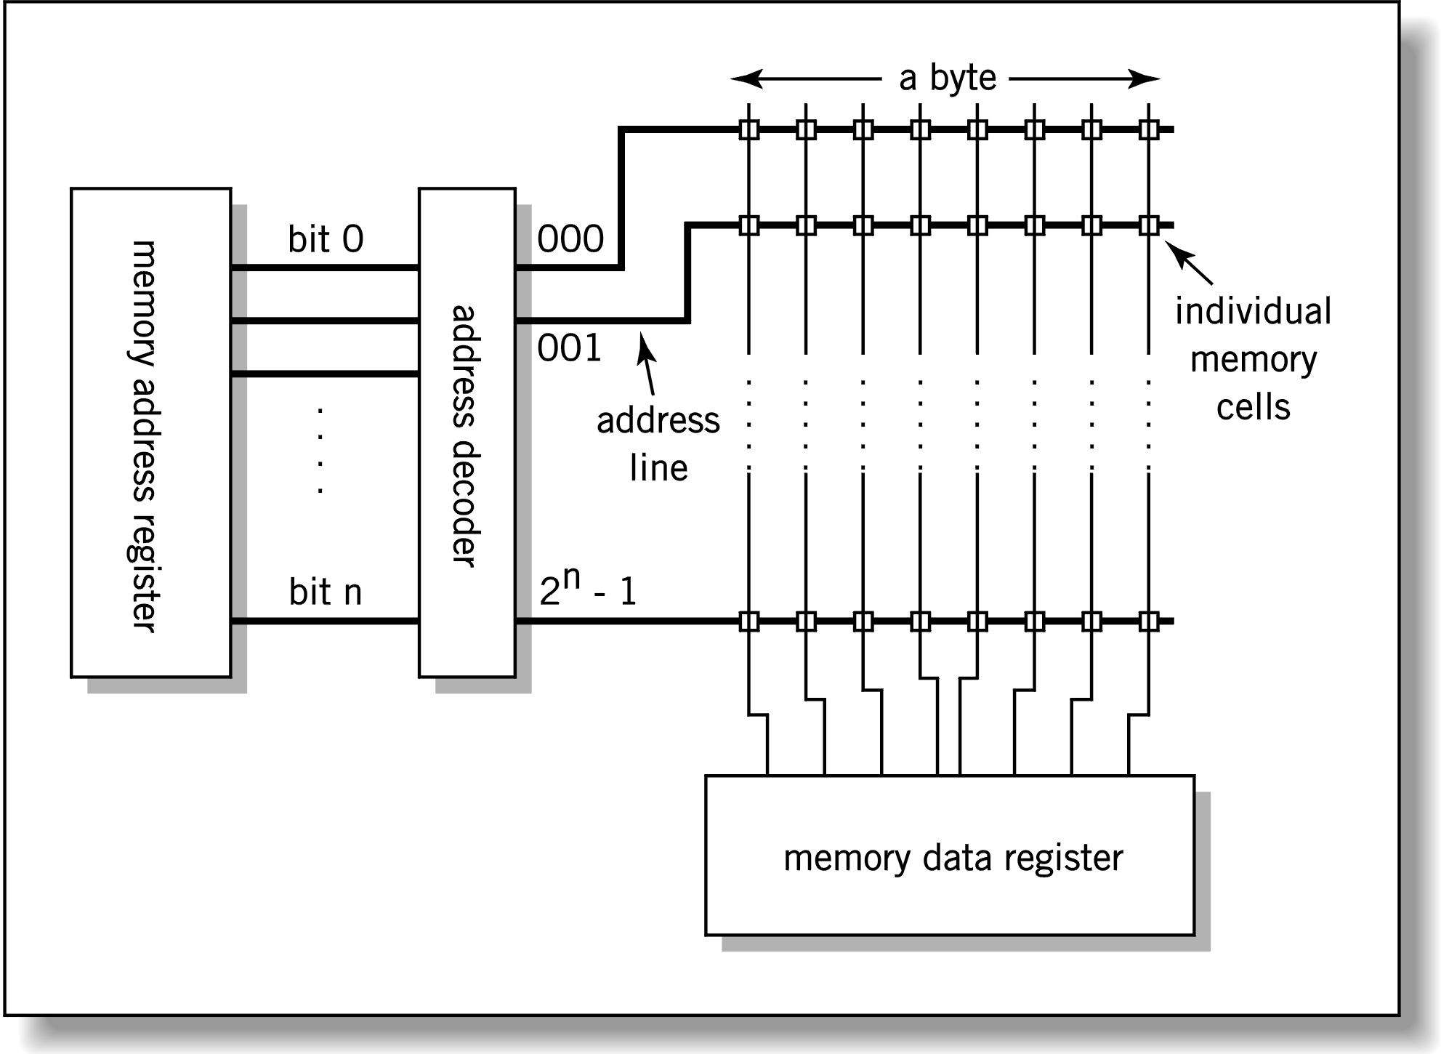
Relationship between MAR, MDR and Memory
Address
Data

Slide 11
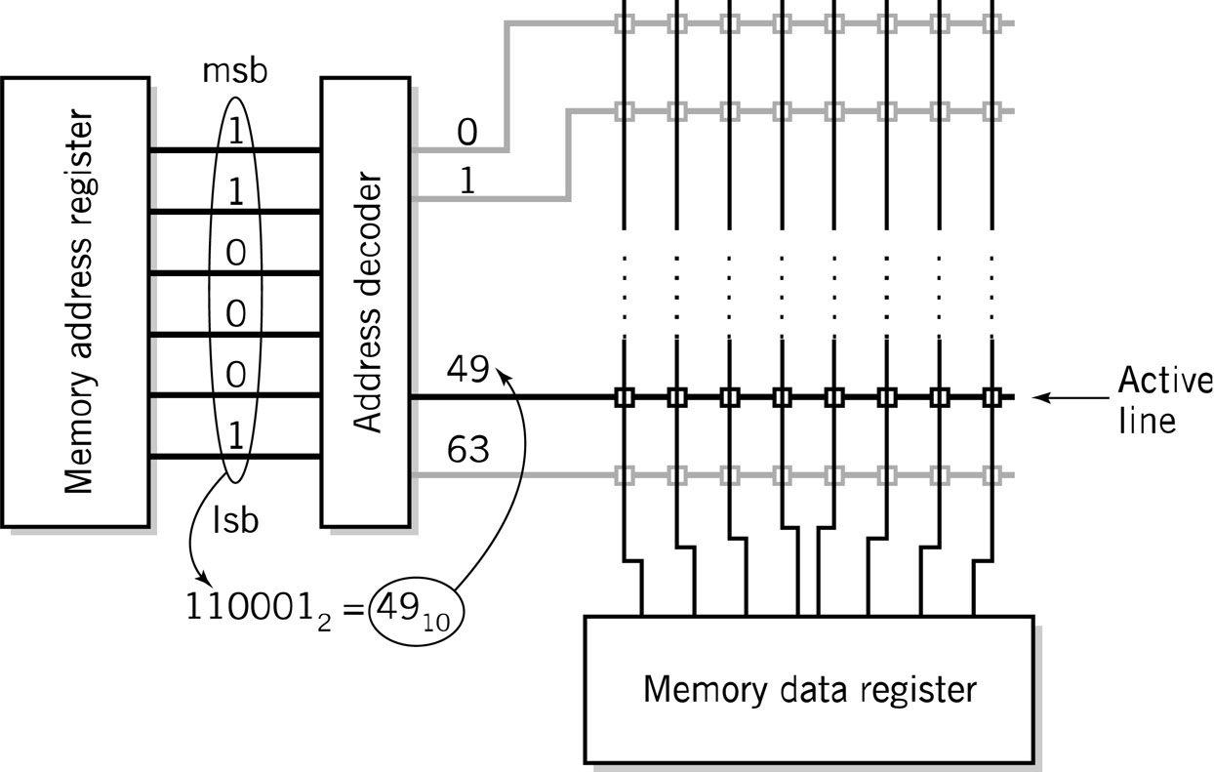
MAR-MDR Example

Slide 12
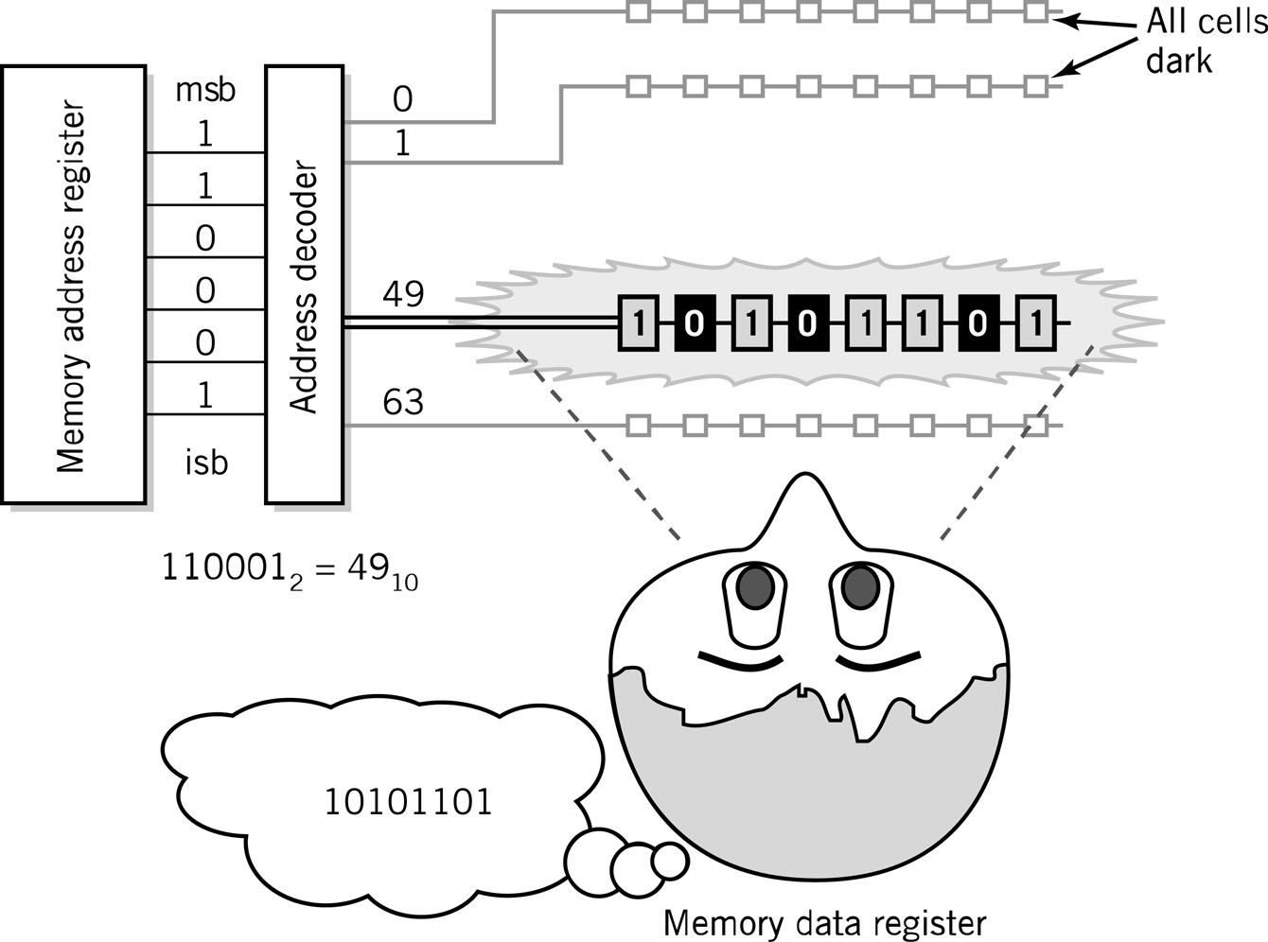
Visual Analogy of Memory

Slide 13
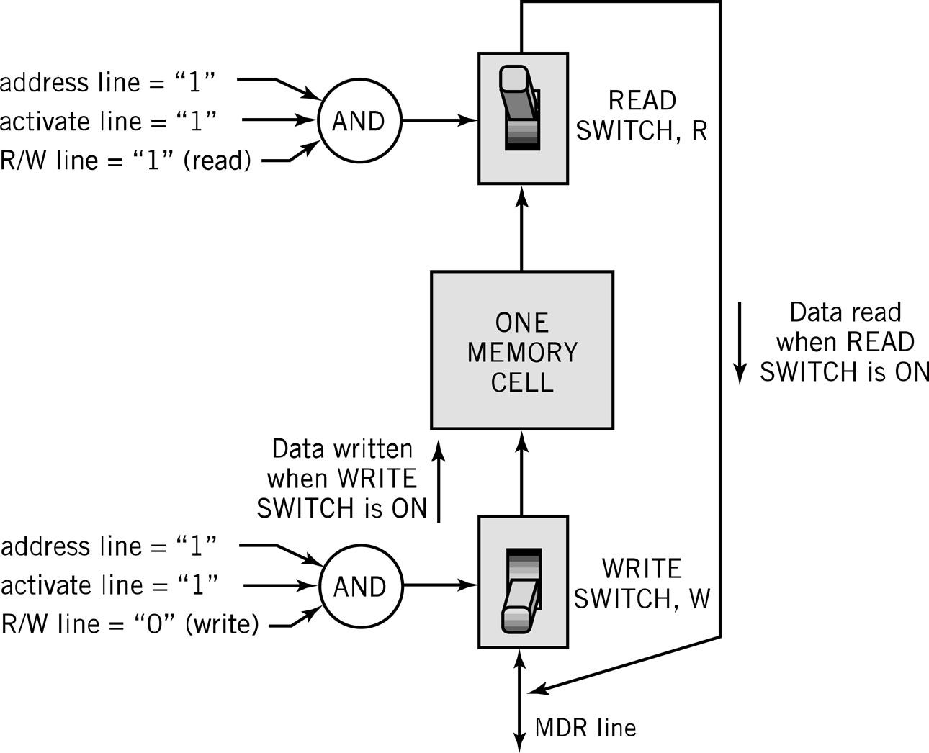
Individual Memory Cell

Slide 14
Memory Capacity
Determined by two factors
1. Number of bits in the MAR
LMC = 100 (00 to 99)
2^{K} where K = width of the register in bits
2. Size of the address portion of the instruction
4 bits allows 16 locations
8 bits allows 256 locations
32 bits allows 4,294,967,296 or 4 GB

Slide 15
RAM: Random Access Memory
DRAM (Dynamic RAM)
Most common, cheap, less electrical power, less heat, smaller space
Volatile: must be refreshed (recharged with power) 1000’s of times each second
SRAM (static RAM)
Faster and more expensive than DRAM
Volatile
Small amounts are often used in cache memory for high-speed memory access

Slide 16
Nonvolatile Memory
ROM
Read-only Memory
Holds software that is not expected to change over the life of the system
EEPROM
Electrically Erasable Programmable ROM
Flash Memory
Faster than disks but more expensive
Uses hot carrier injection to store bits of data
Slow rewrite time compared to RAM
Useful for nonvolatile portable computer storage

Slide 17
Fetch-Execute Cycle
Two-cycle process because both instructions and data are in memory
Fetch
Decode or find instruction, load from memory into register and signal ALU
Execute
Performs operation that instruction requires
Move/transform data

Slide 18
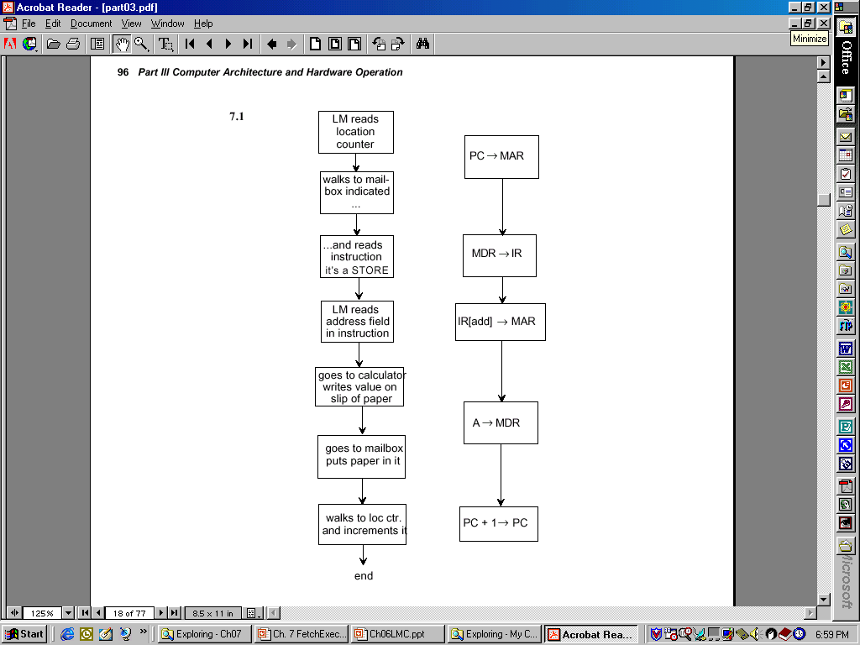
LMC vs. CPU Fetch and Execute Cycle

Slide 19
Load Fetch/Execute Cycle
PC → MAR | Transfer the address from the PC to the MAR
MDR → IR | Transfer the instruction to the IR
IR[address] → MAR | Address portion of the instruction loaded in MAR
MDR → A | Actual data copied into the accumulator
PC + 1 → PC | Program Counter incremented

Slide 20
Store Fetch/Execute Cycle
PC → MAR | Transfer the address from the PC to the MAR
MDR → IR | Transfer the instruction to the IR
IR[address] → MAR | Address portion of the instruction loaded in MAR
A → MDR* | Accumulator copies data into MDR
PC + 1 → PC | Program Counter incremented
*Notice how Step #4 differs for LOAD and STORE

Slide 21
ADD Fetch/Execute Cycle
PC → MAR | Transfer the address from the PC to the MAR
MDR → IR | Transfer the instruction to the IR
IR[address] → MAR | Address portion of the instruction loaded in MAR
A + MDR → A | Contents of MDR added to contents of accumulator
PC + 1 → PC | Program Counter incremented

Slide 22
LMC Fetch/Execute
SUBTRACT
PC → MAR
MDR → IR
IR[addr] → MAR
A – MDR → A
PC + 1 → PC
IN
PC → MAR
MDR → IR
IOR → A
PC + 1 → PC
OUT
PC → MAR
MDR → IR
A → IOR
PC + 1 → PC
HALT
PC → MAR
MDR → IR
BRANCH
PC → MAR
MDR → IR
IR[addr] → PC
BRANCH on Condition
PC → MAR
MDR → IR
If condition false: PC + 1 → PC
If condition true: IR[addr] → PC

Slide 23
Bus
The physical connection that makes it possible to transfer data from one location in the computer system to another
Group of electrical or optical conductors for carrying signals from one location to another
Wires or conductors printed on a circuit board
Line: each conductor in the bus
4 kinds of signals
Data
Addressing
Control signals
Power (sometimes)

Slide 24
Bus Characteristics
Number of separate conductors
Data width in bits carried simultaneously
Addressing capacity
Lines on the bus are for a single type of signal or shared
Throughput - data transfer rate in bits per second
Distance between two endpoints
Number and type of attachments supported
Type of control required
Defined purpose
Features and capabilities

Slide 25
Bus Categorizations
Parallel vs. serial buses
Direction of transmission
Simplex – unidirectional
Half duplex – bidirectional, one direction at a time
Full duplex – bidirectional simultaneously
Method of interconnection
Point-to-point – single source to single destination
Cables – point-to-point buses that connect to an external device
Multipoint bus – also broadcast bus or multidrop bus
Connect multiple points to one another

Slide 26
Parallel vs. Serial Buses
Parallel
High throughput because all bits of a word are transmitted simultaneously
Expensive and require a lot of space
Subject to radio-generated electrical interference which limits their speed and length
Generally used for short distances such as CPU buses and on computer motherboards
Serial
1 bit transmitted at a timed
Single data line pair and a few control lines
For many applications, throughput is higher than for parallel because of the lack of electrical interference

Slide 27
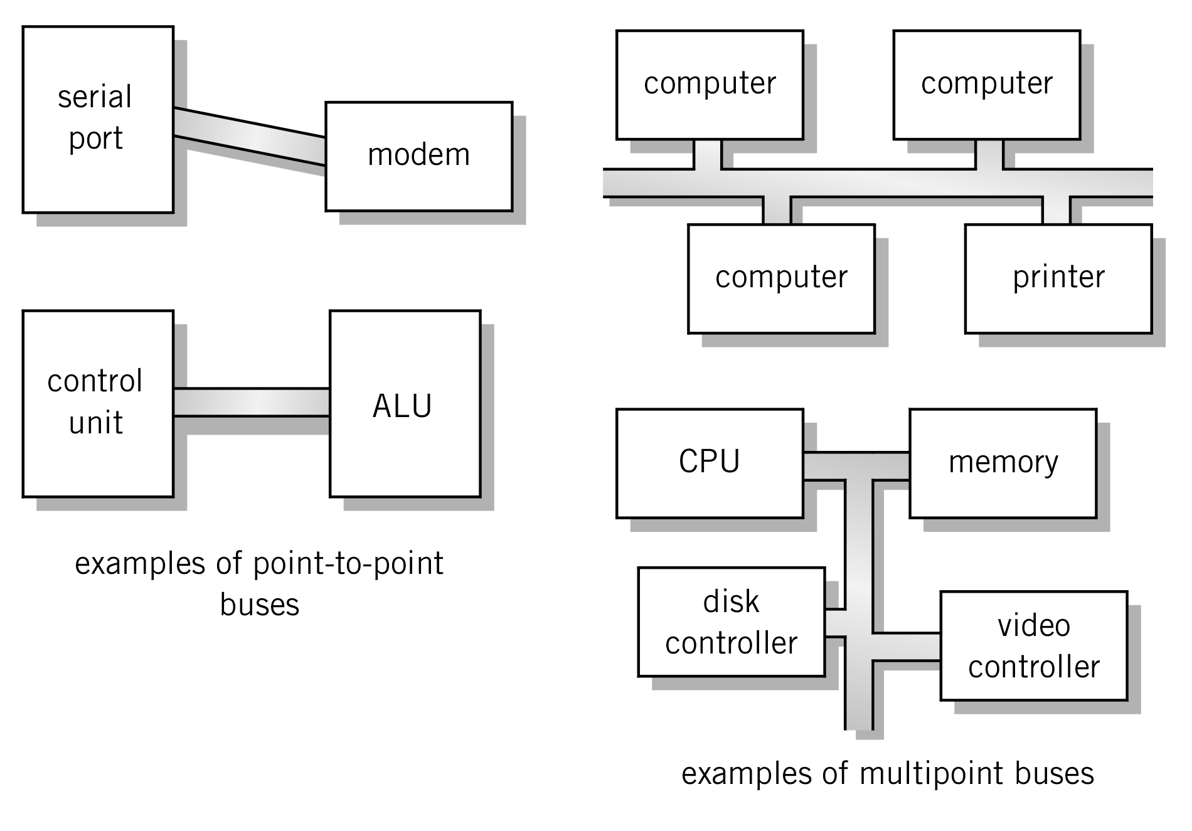
Point-to-point vs. Multipoint
Plug-in device
Broadcast bus Example: Ethernet
Shared among multiple devices

Slide 28
Classification of Instructions
Data Movement (load, store)
Most common, greatest flexibility
Involve memory and registers
What’s this size of a word ? 16? 32? 64 bits?
Arithmetic
Operators + - / * ^
Integers and floating point
Boolean Logic
Often includes at least AND, XOR, and NOT
Single operand manipulation instructions
Negating, decrementing, incrementing, set to 0

Slide 29
More Instruction Classifications
Bit manipulation instructions
Flags to test for conditions
Shift and rotate
Program control
Stack instructions
Multiple data instructions
I/O and machine control

Slide 30
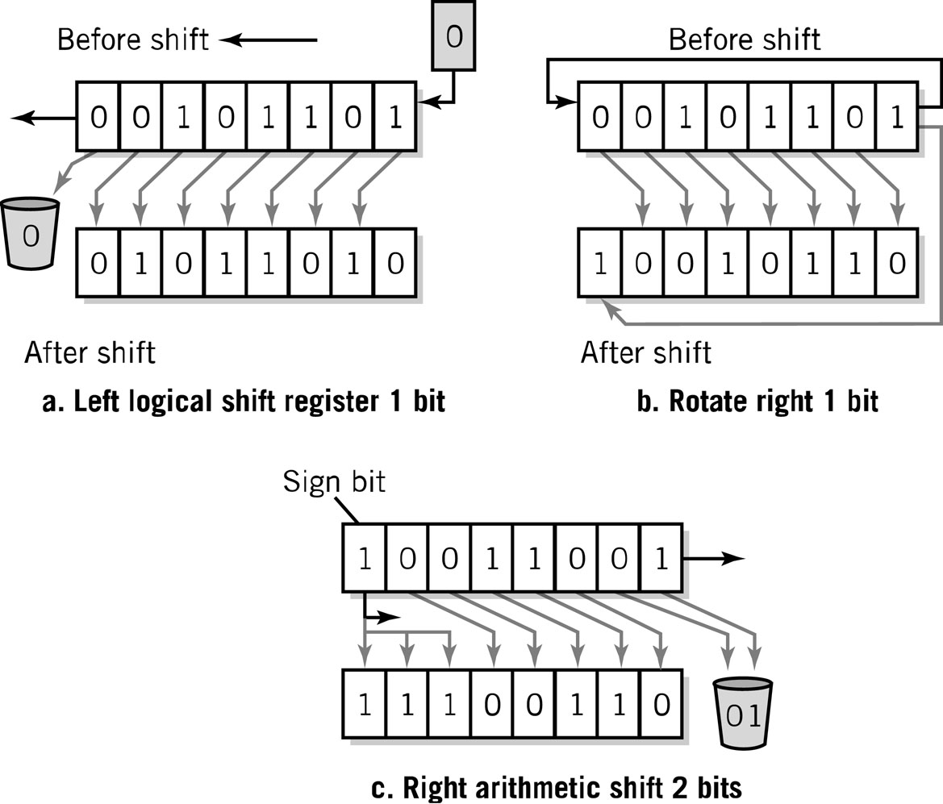
Register Shifts and Rotates

Slide 31
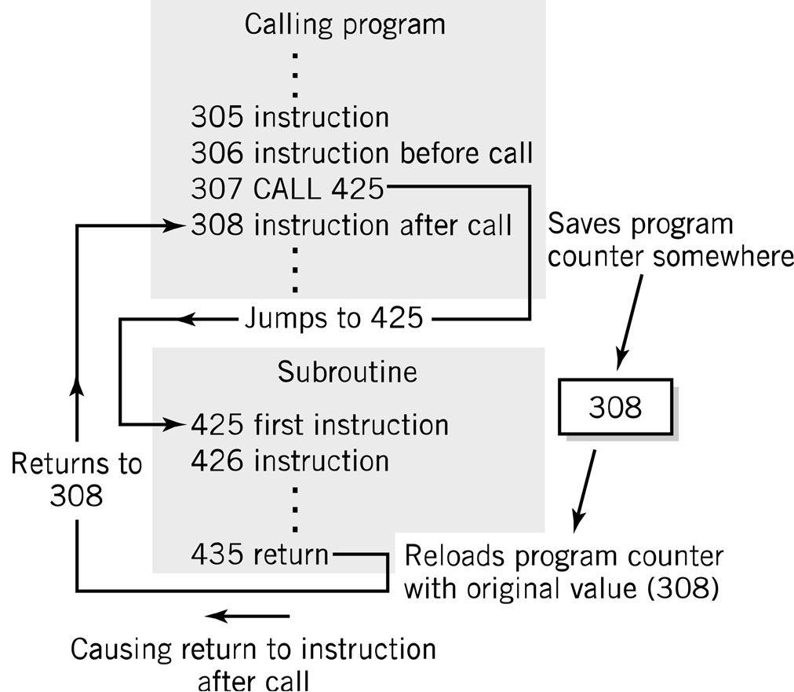
Program Control Instructions
Program control
Jump and branch
Subroutine call and return

Slide 32
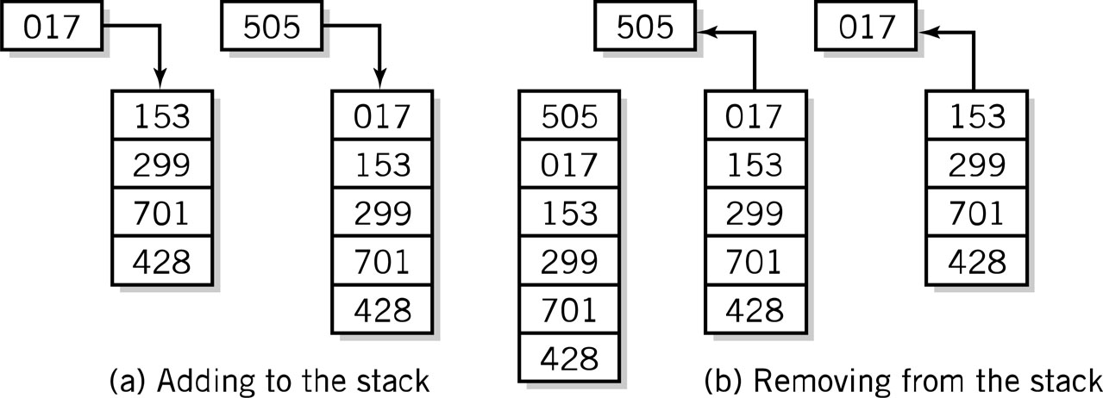
Stack Instructions
Stack instructions
LIFO method for organizing information
Items removed in the reverse order from that in which they are added
Push
Pop

Slide 33
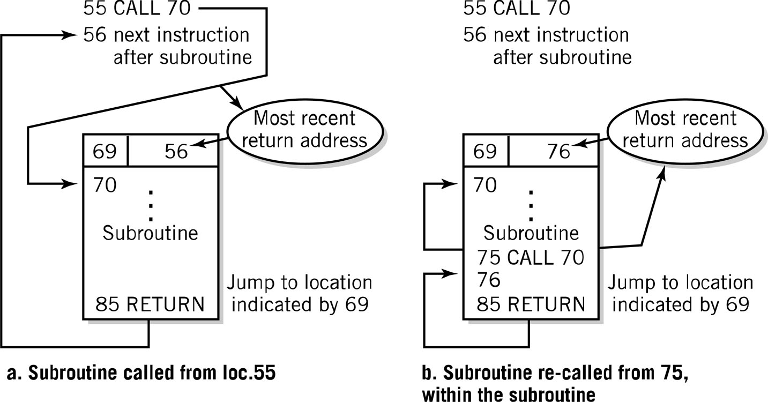
Fixed Location Subroutine Return Address Storage: Oops!

Slide 34
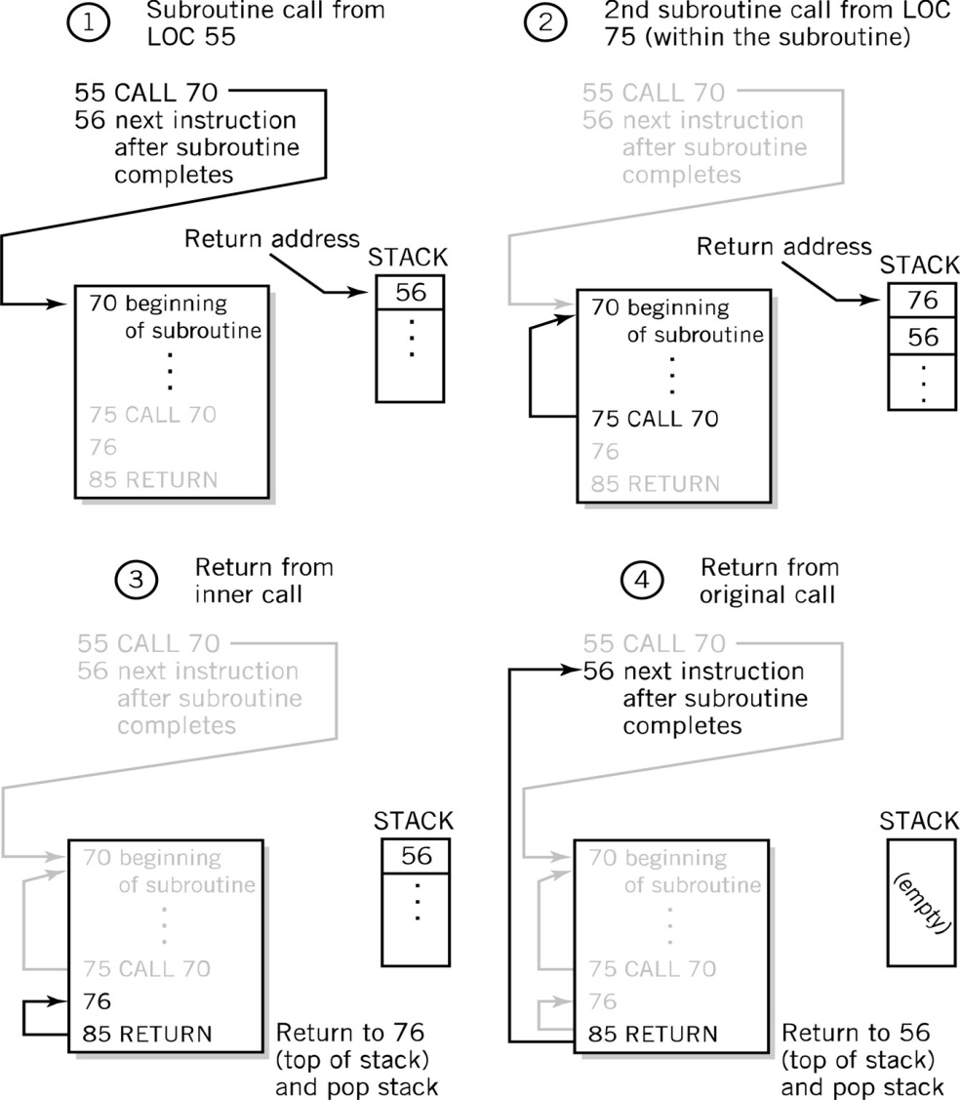
Stack Subroutine Return Address Storage

Slide 35
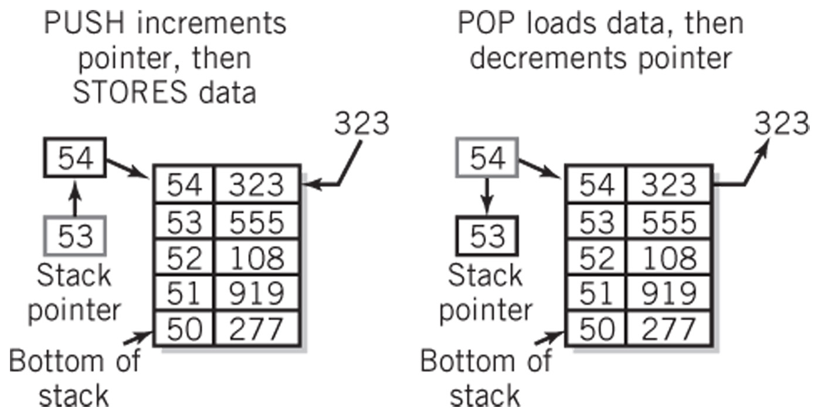
Block of Memory as a Stack

Slide 36
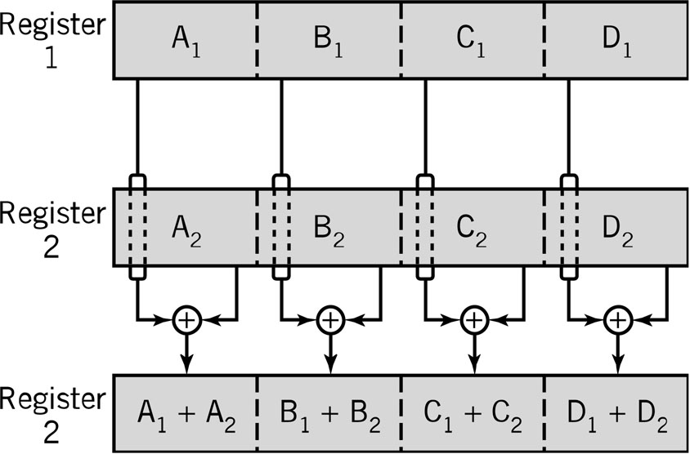
Multiple Data Instructions
Perform a single operation on multiple pieces of data simultaneously
SIMD: Single Instruction, Multiple Data
Commonly used in multimedia, vector and array processing applications

Slide 37
Instruction Elements
OPCODE: task
Source OPERAND(s)
Result OPERAND
Location of data (register, memory)
Explicit: included in instruction
Implicit: default assumed
Addresses
Source
OPERAND
Result
OPERAND
OPCODE

Slide 38
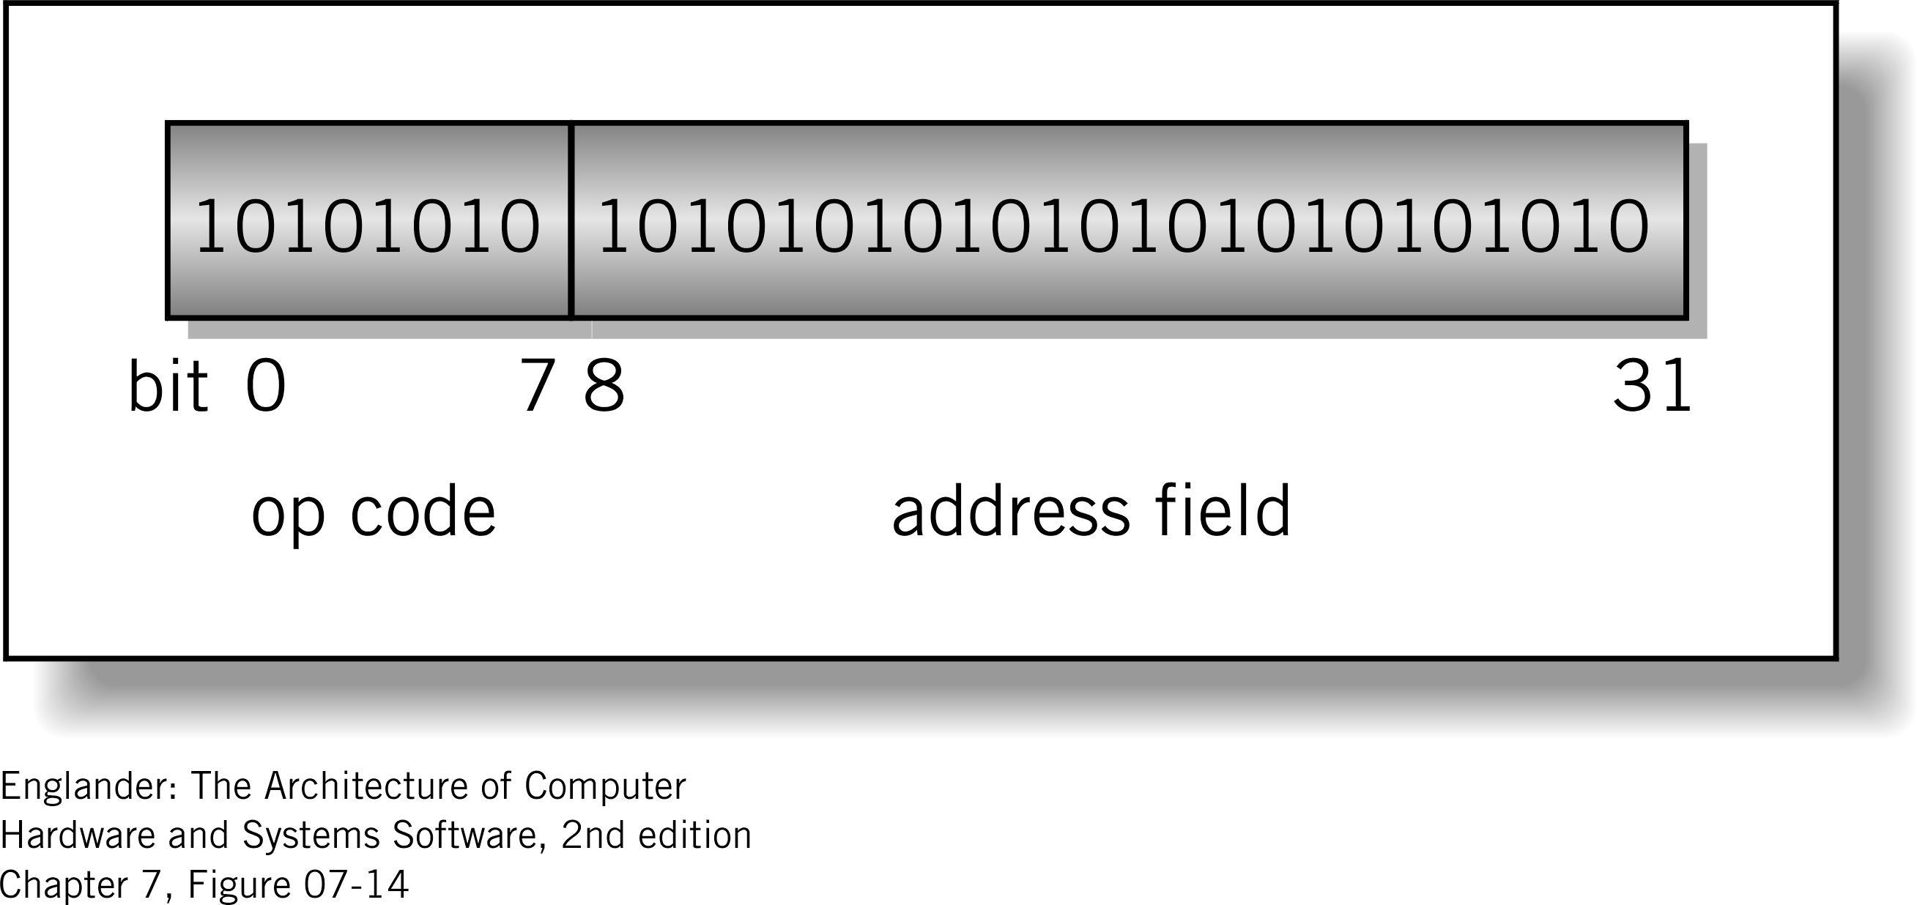
Instruction Format
Machine-specific template that specifies
Length of the op code
Number of operands
Length of operands
Simple 32-bit Instruction Format

Slide 39
Instructions
Instruction
Direction given to a computer
Causes electrical or optical signals to be sent through specific circuits for processing
Instruction set
Design defines functions performed by the processor
Differentiates computer architecture by the
Number of instructions
Complexity of operations performed by individual instructions
Data types supported
Format (layout, fixed vs. variable length)
Use of registers
Addressing (size, modes)

Slide 40
Instruction Word Size
Fixed vs. variable size
Pipelining has mostly eliminated variable instruction size architectures
Most current architectures use 32-bit or 64-bit words
Addressing Modes
Direct
Mode used by the LMC
Register Deferred
Also immediate, indirect, indexed

Slide 41
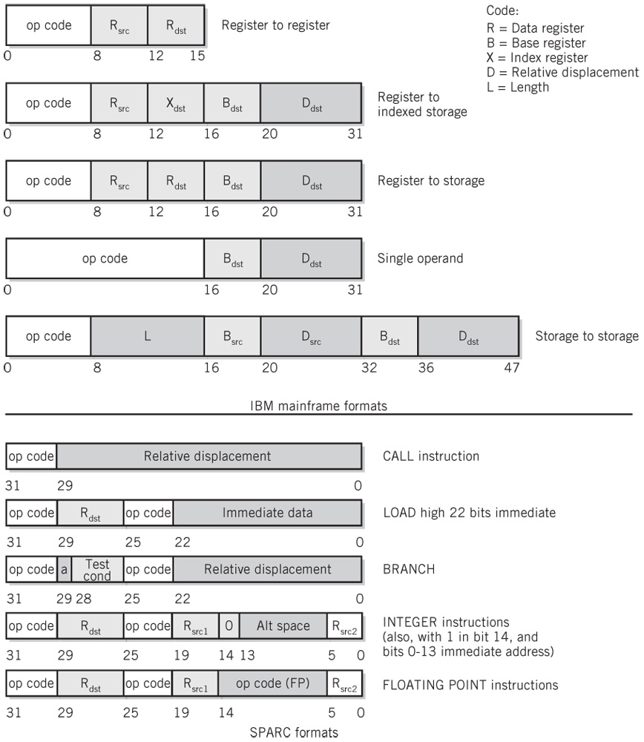
Instruction Format Examples

